Slide 1
UNIVERSITY INSTITUTE OF COMPUTING
Bachelors of Computer Applications/Science
Minor Project
22CAR-304
Made Setup
An Overview
of Computing
&
Career Planning
Student Name: Dhruv Jindal
UID: 22BCA10288
Section/Group: 22BCA-3‘A’
Supervisor Name: Ms Jasleen Kaur
Employee Code: E16528
Designation: Professor
Minor Project Presentation
DISCOVER . LEARN . EMPOWER

Slide 2
Presentation Outline
Introduction to Project
Technology Used
Existing Gaps & Project Features
Objectives
Scope/Relevance
Project Flow Diagram
ER Diagrams
Test Cases
Comparative Analysis
Conclusion & Future Aspects
Bibliography
Note: In Conclusion kindly mention Software Model used & Project Cost

Slide 3
Introduction to Project
"Made Setup" is an e-commerce platform designed to provide users with a seamless shopping experience for all their setup needs. Whether you're a gamer seeking high-performance equipment, a designer in need of creative tools, or an office worker looking for productivity solutions, the platform offers a wide range of products across different categories. With its intuitive interface, secure payment options, and real-time order tracking, "Made Setup" simplifies the process of customizing and upgrading setups. The platform is a one-stop solution catering to diverse user needs, ensuring convenience, variety, and ease of use for all customers.

Slide 4
Technology Used
Frontend: HTML5, CSS3, JavaScript, and Bootstrap for a responsive, dynamic, and user-friendly interface.
Backend: PHP for server-side scripting and MySQL for database management.
APIs: Payment Gateway APIs for secure transactions and Google Maps API for delivery tracking.
Other Tools: Git for version control and SwiperJS for responsive carousels.

Slide 5
Existing Gaps & Project Features
Existing Gaps:
Lack of specialized e-commerce platforms for setup-related products.
Limited customizable setup options.
Poor product categorization and user experience on existing platforms.
Project Features:
Specialized Categories for gamers, designers, and office setups.
Customizable Setup Options for easy upgrades.
User-Friendly Interface for smooth navigation.
Real-Time Order Tracking and secure payment options.

Slide 6
Objectives
Provide a One-Stop Platform: Offer a comprehensive selection of products for various setup categories like gaming, office, and design.
Enhance User Experience: Create a user-friendly interface with easy navigation, product filtering, and responsive design.
Facilitate Customization: Allow users to easily customize and upgrade their setups with diverse product options.
Ensure Secure Transactions: Implement secure payment gateways to protect user information and enable hassle-free purchases.
Real-Time Tracking: Provide users with real-time order tracking from purchase to delivery.

Slide 7
Scope/Relevance
The "Made Setup" project targets gamers, designers, office users, and PC enthusiasts by providing a specialized e-commerce platform for setup-related products.
Key Points:
Customizable Options: Users can build and personalize their setups.
User-Friendly Experience: Simplified navigation and secure shopping.
Market Demand: Addresses the growing need for tailored setups in various fields.

Slide 8
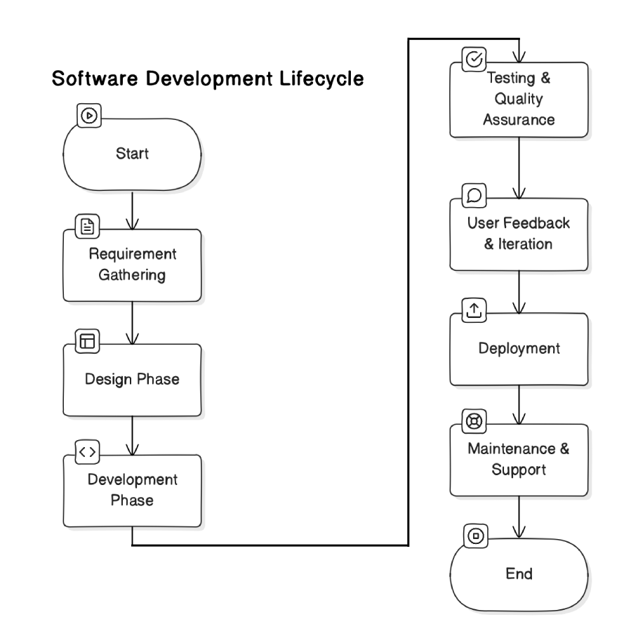
Project Flow Diagram

Slide 9
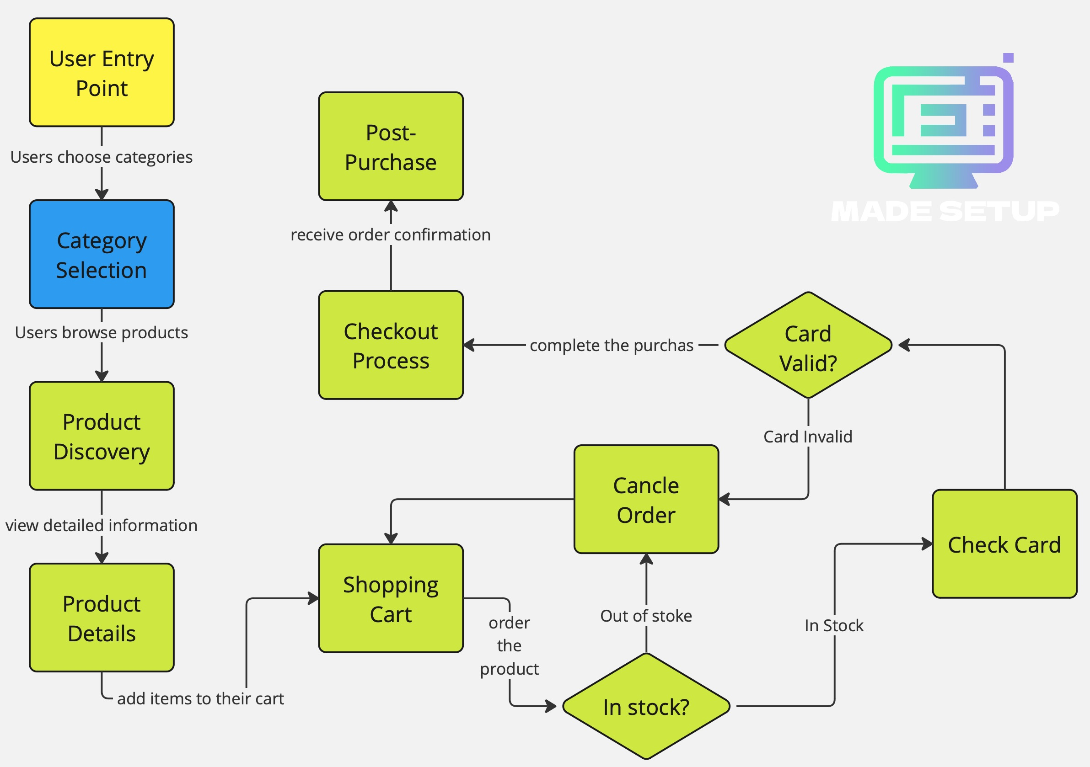
ER Diagrams

Slide 10
Test Cases
Test Case ID | Description | Input | Expected Output | Status

Slide 11
Comparative Analysis
The Comparative Analysis evaluates "Made Setup" alongside key competitors in the e-commerce market, focusing on specialization, customization, and user experience.
Criteria | Made Setup | Competitor A | Competitor B
Specialization | Focused on setup products (gaming, office, design) | General e-commerce products | Broad, non-specific categories
Customization Options | Extensive customization available | Limited customization options | Minimal customization
User Interface | Intuitive and user-friendly | Basic interface | Moderate user-friendliness
Product Range | Wide range of setup-specific items | Broader, general categories | Limited selection for setups
Customer Support | 24/7 support via multiple channels | Limited support hours | Email support only
Order Tracking | Real-time tracking available | Standard tracking | Basic tracking available

Slide 12
Conclusion
The "Made Setup" project successfully created a specialized e-commerce platform for setup products, utilizing the Agile software model for iterative development. The total project cost is approximately $20,000, encompassing development, design, testing, and marketing.
The platform stands out for its user experience, customization options, and strong customer support, positioning it well against competitors.

Slide 13
Future Aspects
Feature Expansion: Introducing augmented reality (AR) for product visualization.
Mobile App Development: Launching a mobile application for increased accessibility.
Market Research: Ongoing analysis to adapt to emerging trends.
Sustainability Practices: Implementing eco-friendly sourcing and packaging.
Enhanced Customer Support: Expanding support channels, including AI chatbots.

Slide 14
Bibliography
1. Books:
Smith, J. (2020). E-commerce Essentials. New York: Business Press.
Johnson, A. (2019). User Experience Guide. London: Design Publishers.
2. Articles:
Doe, R. (2021). "Customization in E-commerce." Journal of Marketing Research, 58(2), 134-145.
Patel, M. (2022). "E-commerce Trends." International Journal of Business, 14(3), 87-99.
3. Websites:
E-commerce Times. (2023). "Niche E-commerce Platforms." ecommercetimes.com.
Statista. (2024). "E-commerce in India." statista.com.
4. Reports:
Market Research Future. (2023). E-commerce Market Report. marketresearchfuture.com.

Slide 15
THANK YOU

